Slide 1
Predicting Default Rates of Peer-to-Peer Loans
By Tim Copeland

Slide 2
Background
Lending club is a peer-to-peer lending service
Variance of returns comes from interest rate and number of defaults in a portfolio
Better predictions = better returns

Slide 3
Data Cleaning and Exploration
Change dates to useable format
Python datetime class
Changed dates to ”time since,” for some factors
Some discrete variables made into boolean + discrete
Boolean variables for class
Log transformations

Slide 4
Data Cleaning and Exploration (Cont.)
Training data set: Loans originating between January 2010 and December 2013
Testing data set: Loans originating between January 2014 and December 2014
Walk-forward testing: Loans originating between January and July of 2015

Slide 5
Problem and Approach
Distinct from “traditional,” classification problem
Probabilistic in nature
Interest rate
Used a mix of traditional model evaluators and __
Area under the ROC-AUC curve
Graphed predicted vs. actual repayment
Out-of-sample returns
pass

Slide 6
Modeling
We tried a couple different types of models, but the following 3 performed best:
Logistic Regression
Random Forest
Gradient Boosting

Slide 7
Logistic Regression
Advantages:
Quick runtime
Parameter estimates
Likely accurate probability estimates
Tried 3 different specifications:
Borrower characteristics
Borrower characteristics + interest rate + loan grade
Borrower characteristics + interest rate + loan subgrade

Slide 8
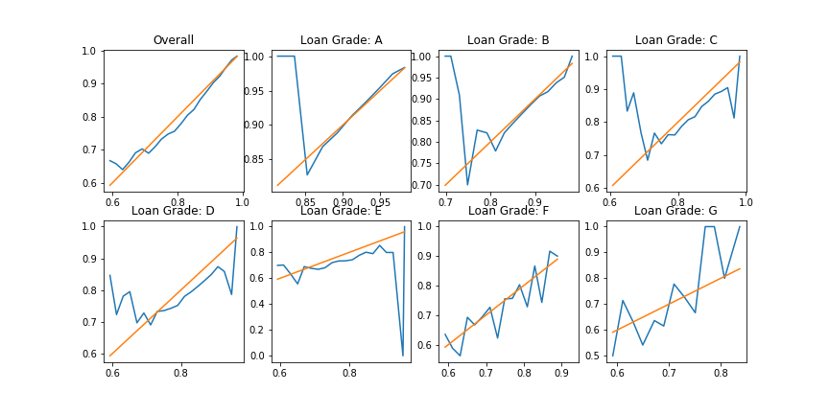
Logistic Regression (cont.)

Slide 9
Random Forest
Advantages:
Extremely effective classifier
Potential disadvantages:
Longer runtime
Used RandomSearch to find optimal hyperparameters
Created one model with resampled data (ADASYN)

Slide 10
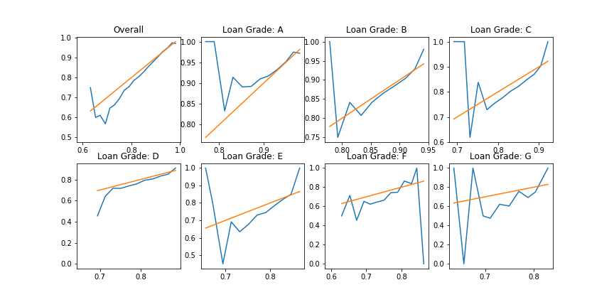
Random Forest (cont.)

Slide 11
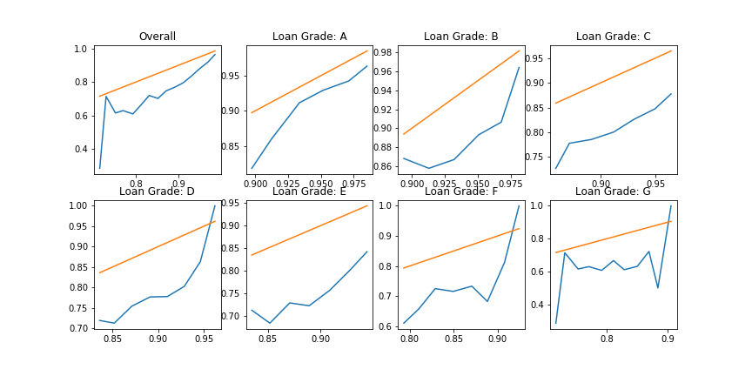
Random Forest with Resampling

Slide 12
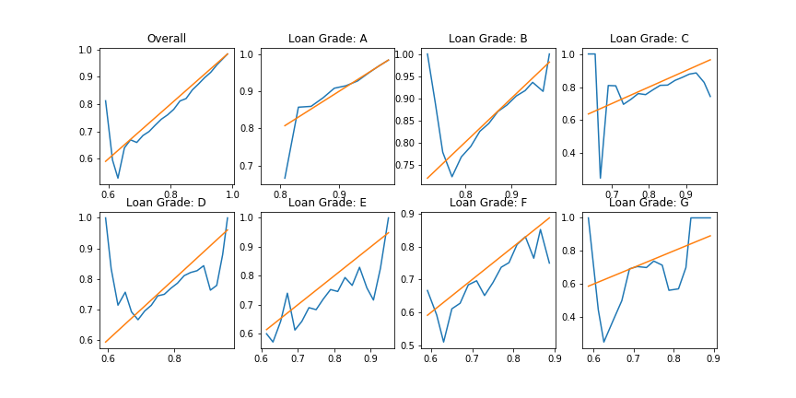
Gradient Boosting Classifier

Slide 13
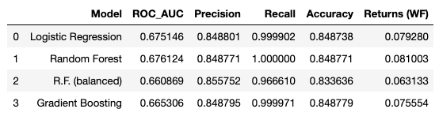
Results

Slide 14
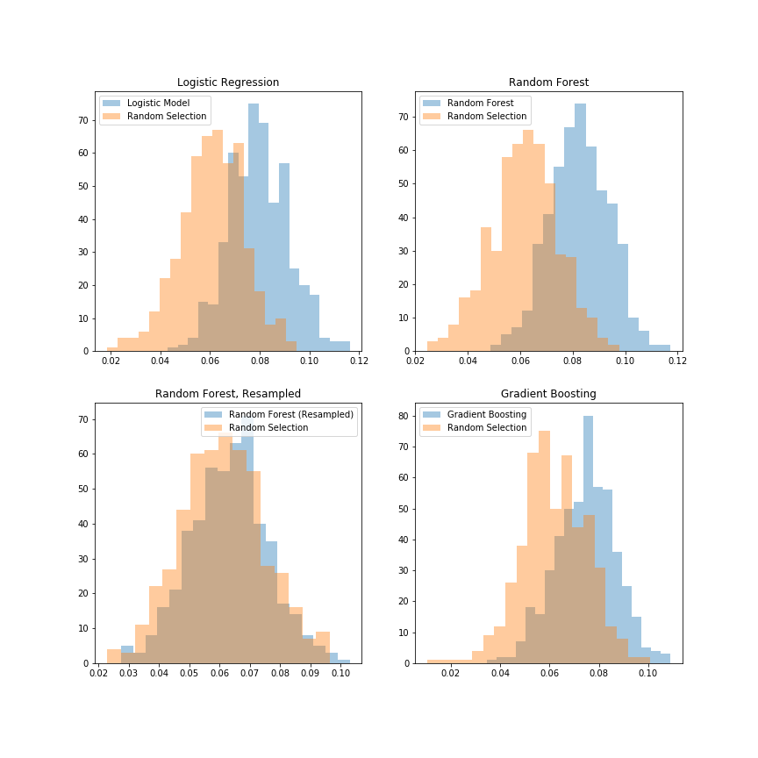

Slide 15
Putting the model into production
Wanted to show the ability to utilize a model in the context of an end product
Wrote a standalone application that downloaded live data and used the model’s prediction to evaluate which loans were the best options

Slide 16
Steps
Fitting, saving, and loading model
Communicating with the Lending Club API
Processing and cleaning live data
Predict repayment probability using model
Creating a user interface

